Slide 1
Stanford Center on Philanthropy & Civil Society
Effective Philanthropy Learning Initiative
https://pacscenter.stanford.edu/research/effective-philanthropy-learning-initiative/
Notes:
https://pacscenter.stanford.edu/research/effective-philanthropy-learning-initiative/

Slide 2
This work is derived from “The Stanford PACS Philanthropy Toolkit” by Stanford Center on Philanthropy and Civil Society, copyright 2021 Board of Trustees of The Leland Stanford Junior University, used under Creative Commons Attribution 4.0 license. The complete Toolkit can be found online for free, or you can purchase print copies here: https://pacscenter.stanford.edu/the-philanthropy-toolkit/

Slide 3
Finding
Your Focus
Notes:
Articulating your motivations and values allows you to develop a proactive, effective philanthropic plan rather than giving reactively to funding requests. Ultimately, your motivations and values provide the anchor for decision-making at each step of the philanthropy process. You should always start with clarity about what you care about before choosing giving vehicles or organizations to support.
This exercise is 100% subjective, there are no “wrong” answers.
This activity can be done alone or with others. We also have a published card deck game in our Stanford Effective Philanthropy Toolkit which is fun for the “in person dinner table” version.
Toolkit print-version: https://stanford-pacs-effective-philanthropy-learning-initiative.myshopify.com/products/the-philanthropy-toolkit
Card deck alone: https://stanford-pacs-effective-philanthropy-learning-initiative.myshopify.com/products/issues-and-value-cards

Slide 4
Finding your focus
How do effective philanthropists start their journey?
Activity Set-up: Grab your pen & paper
Notes:
Grab a pen and paper, and a timer!

Slide 5
Notes:
Take one minute to think about moments or life experiences that have shaped you--maybe someone you love has had an illness, maybe you’re really passionate about deserving young people getting a great education, maybe you love and want to protect nature?
Begin.
60 seconds later…

Slide 6
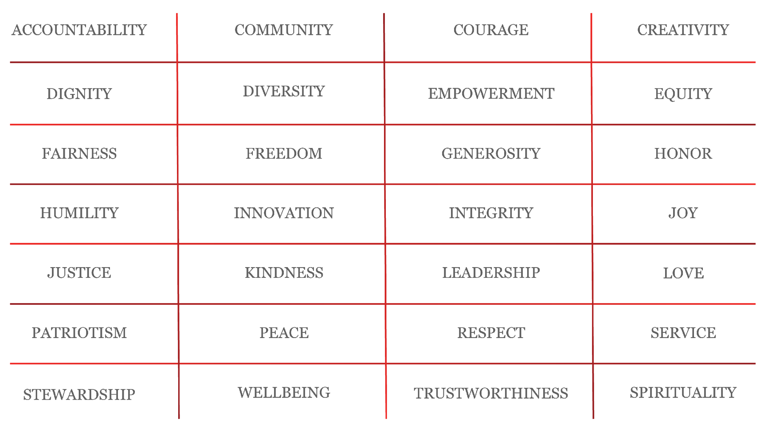
Finding Your Focus: Values Exercise
Notes:
Now doing a deeper dive into that-- hat are the VALUES that drive your passion for that topic or came out of those experiences?
Take 90 seconds to read this values list--write down all the values that you relate to strongly.
Don’t overthink it! Circle anything that speaks to you. Add your own!
Begin.
90 seconds later…
Now, have another look at your list.
Take one minute to circle the 3 that speak to you the MOST.
Begin.
60 seconds later…

Slide 7
Your Values Statement
If [Value 1], [Value 2], and [Value 3]
were flourishing in the world,
it would address many of the problems
I care about.
Notes:
Take one minute to take the 3 values you just circled and insert them into this statement.
For example: “If equity, kindness, and generosity were flourishing in the world, it would address many of the problems I care about.”
Begin.
60 seconds later…

Slide 8
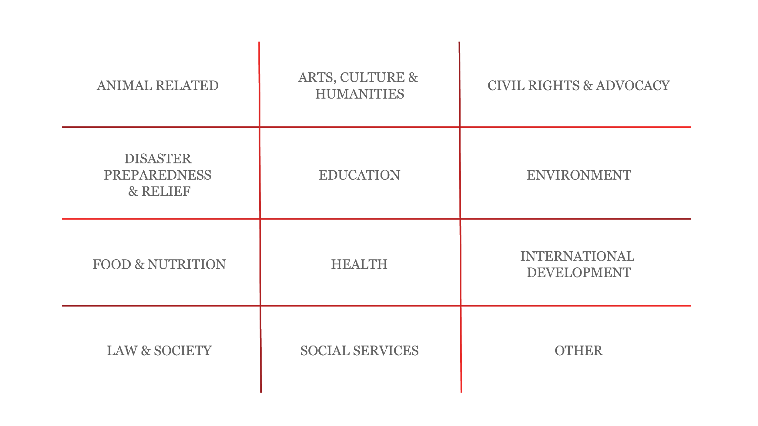
Finding Your Focus: Issues Exercise
Notes:
The next step in this exercise is to think through the issue areas or causes that are important to you. Maybe you’ve given to some of these in the past, maybe you have new priorities based on current events—it's important to remember that your giving priorities can change over time and it’s OK to bring in new ones that aren’t necessarily tied to your past life experiences. Here again, feel free to add in your own or drill down as necessary: education is a huge category!
Take one minute to pick 1-3 causes that particularly stand out.
Begin.
60 seconds later…

Slide 9
Your Issues Statement
If I could make a significant difference on [Issue 1], [Issue 2], and [Issue 3],
I would be pleased to have made that impact
in the world.
Notes:
In one minute, take those 3 issues you just circled and insert them into this sentence.
For example, I might say “If I could make a significant difference in early childhood education, I would be proud to have made that impact in the world.”
Begin.
60 seconds later…

Slide 10
Your Focus Statement
The [name of your fund/foundation] is [committed to/believes in] [Value 1], [Value 2], and [Value 3].
We aim to [address/support/eradicate] [Issue 1], [Issue 2], and [Issue 3] for [target population]
throughout the [world/country/local geographic area].
Notes:
Let’s put this all together. Put your values into the first sentence, and your funding areas into the second sentence.
At this step, if you’re ready, you may also want to call out the who and where you want to focus on.
Who are the communities you wish to support? Where do they live?
Take 3 minutes to write your first draft.
Begin.
3 minutes later…
A few examples:
The Andrews Family values community, equity, self-actualization, and kindness. We look to support community-based organizations in the Bay Area led by people of color in the fields of education and social justice. In particular, in the education space, we are interested in supporting low-income, underserved elementary school-aged children and high-schoolers on the path to college.
The RNR Foundation is committed to equity, dignity and innovation. We are first-mover funders on untested new initiatives promoting learning & wellbeing & for people & the planet in communities across the United States.

Slide 11
Conclusion
Notes:
This 20-minute exercise is just a start. Feel free to spend more time refining and drafting your priorities.
This exercise is a natural starting point for any donor, however it does center the donor’s priorities above other possible priorities. An alternative approach is to think through your motivations and values and then rather than choose causes, select specific communities or beneficiaries you’d like to support through your philanthropy. In this case, you’d connect with those communities or individuals to decide which causes to support and approaches to take. This type of philanthropy is called “participatory philanthropy.” You can read more about this type of philanthropy in a new chapter in the Guide to Effective Philanthropy: https://pacscenter.stanford.edu/wp-content/uploads/2021/10/Guide_FINAL_chpt.13_8.5x11.pdf
To wrap up: Articulating your focus statement helps you choose the right giving vehicle, find the right nonprofits to support, and it’s a powerful tool to say no. Having clarity about what you do want to fund, makes it easier to gracefully decline solicitations that aren’t the right fit.
You should revisit your focus statement from time to time and it’s fine if it shifts over time.

